Slide 1
Power Bi
i. Column level formatting and coloring background color based on conditions and gradients ii. Font color formatting iii. Data bars iv. Icons v. Conditional formatting on other chart types and controlling the same vi. Tree maps

Slide 2
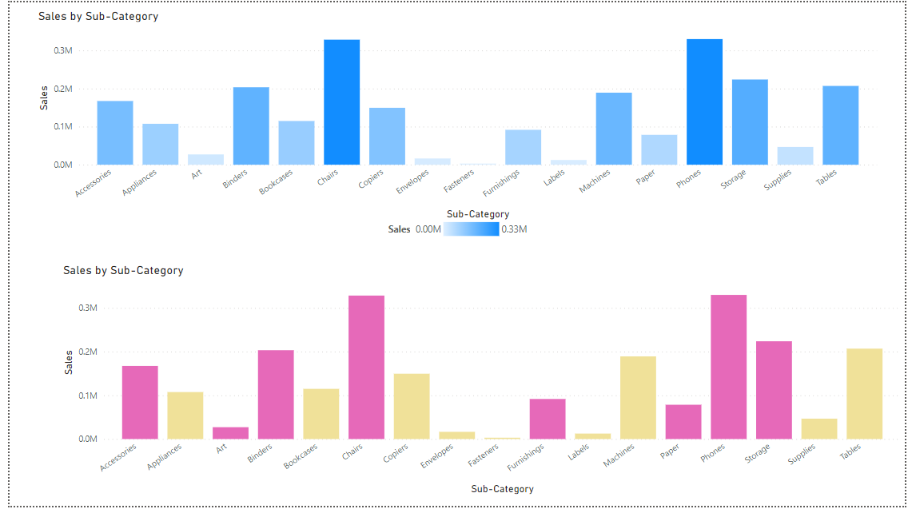
Column level formatting and colouring background colour based on conditions and gradients

Slide 3
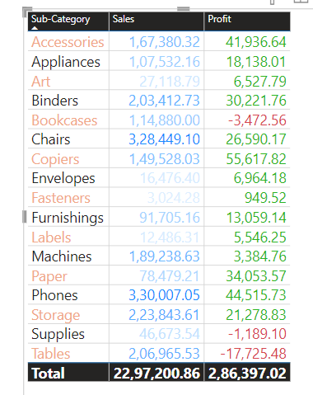
Font colour formatting

Slide 4
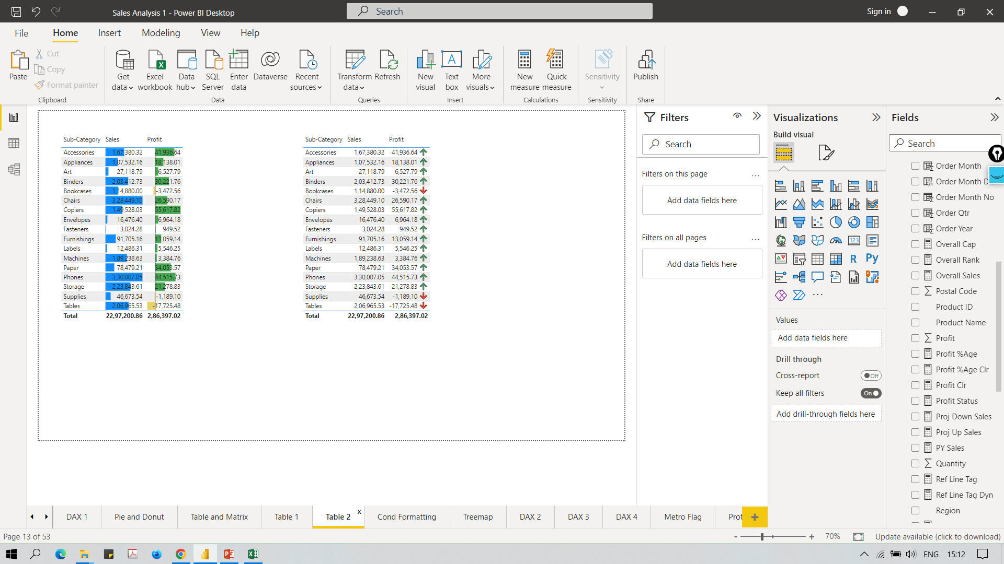
Data bars

Slide 5
Icons

Slide 6
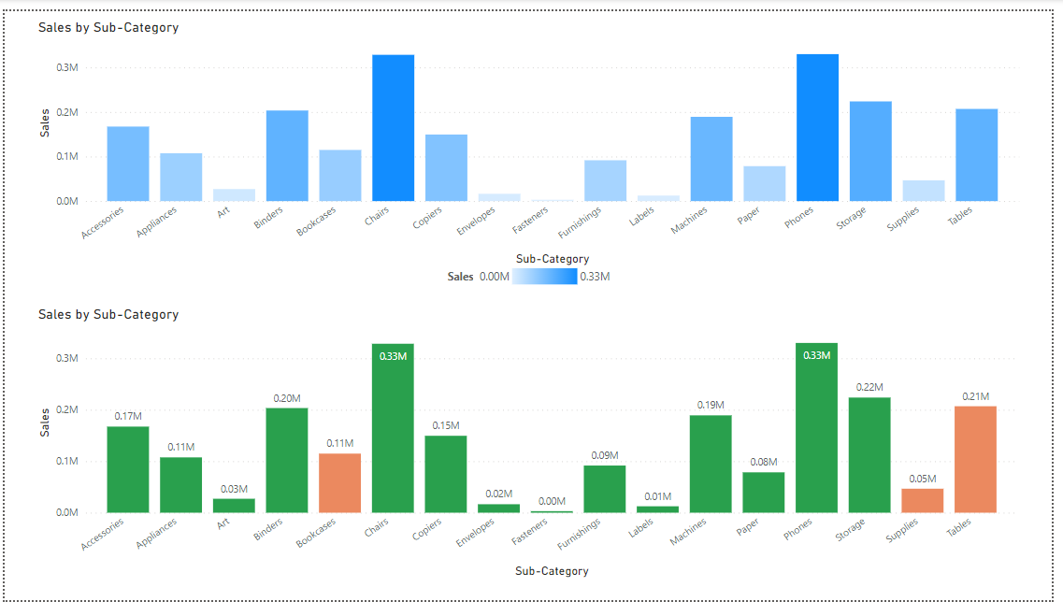
Conditional formatting on other chart types and controlling the same

Slide 7
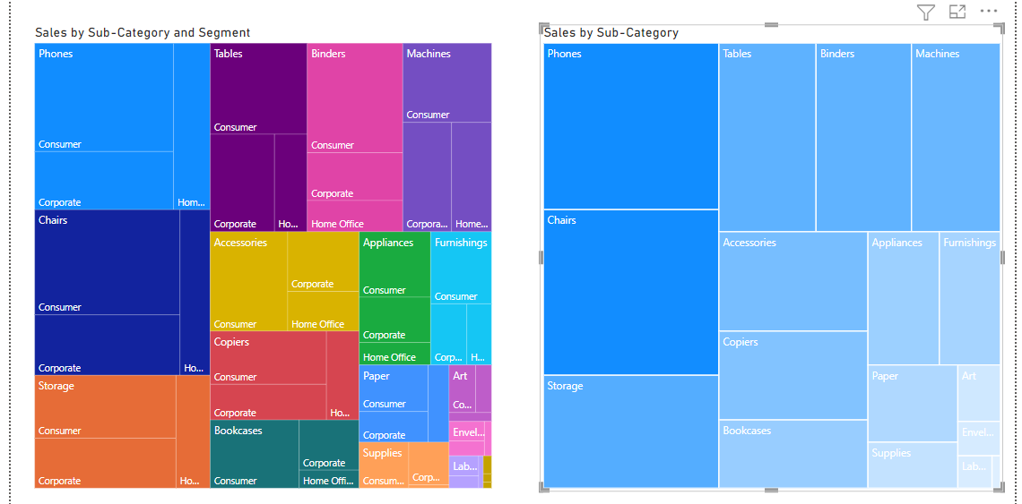
Tree Map

